Slide 1
IR Models – Vector Space Models

Slide 2
Drawbacks of Boolean model
Frequency – not considered
Documents either match or don’t match a query
Results often result in either too few (=0) or too many (1000s) results
Good for expert users with precise understanding of their needs and of the collection. It takes a lot of skill - query
Also good for applications: Applications can easily consume 1000s results - Most users don’t want to wade through 1000s of results - This is particularly true of web search.

Slide 3
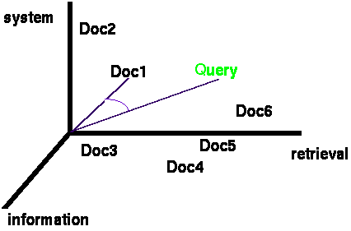
Vector space model
Documents - “Bags of Words”
Documents - vectors in term space
Terms are usually stems
Documents - real valued vectors of terms
Queries are represented the same as documents
Query and Document weights are based on length and direction of their vector
A vector distance measure between the query and documents is used to rank documents
Doc1 (2.4T₁, 4.3T₂, 6.8 T₃,… 1.2T_{n} )

Slide 4
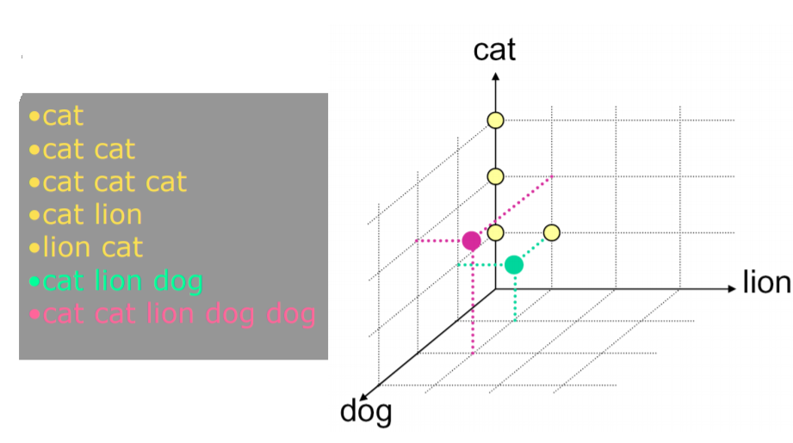
Vector Representation

Slide 5
Vector Representation
nova galaxy heat actor film role
A 1.0 0.5 0.3
B 0.5 1.0
C 1.0 0.8 0.7
D 0.9 1.0 0.5
E 1.0 1.0
F 0.7
G 0.5 0.7 0.9
H 0.6 1.0 0.3 0.2
I 0.7 0.5 0.3
a document
vector

Slide 6
Bag of words model
We do not consider the order of words in a document.
John is quicker than Mary
Mary is quicker than John
This is called a bag of words model.
A step back: The positional index was able to distinguish these two documents.
represented the same way.

Slide 7
Term weights
Term frequency
Normalized term frequency
TF * IDF

Slide 8
Term Frequency
The term frequency tf_{t,d} of term t in document d is defined as the number of times that t occurs in d.
Use tf when computing query-document match scores
Raw term frequency is not sufficient
A document with tf = 10 occurrences of the term is more relevant than a document with tf = 1 occurrence of the term - But not 10 times more relevant.
Relevance does not increase proportionally with term frequency
Longer documents – more frequency
Doc1 : term1, term1, …. 10 times
Doc2 : term1

Slide 9

Normalized term frequency
The term frequency tf_{t,d} of term t in document d is defined as the number of times that t occurs in d.
Longer documents – more frequency
Maximum tf normalization - Normalise
0<=a<1

Slide 10
Example
Doc1 | SaS | PaP | WH
affection | 115 | 58 | 20
jealous | 10 | 7 | 11
gossip | 2 | 0 | 6
Doc1: Sense and Sensibility
Doc2: Pride and Prejudice
Doc3: Wuthering Heights
SaS: (115, 10,2)
PaP: (58,7,0)
WH: (20,11,6)
SaS: (1, 0.087,0.0174)
PaP: (1,0.121,0)
WH: (1, 0.55, 0.3)

Slide 11
Desire for rare terms
Rare terms are more informative than frequent terms.
Consider a term in the query that is rare in the collection (e.g., ARACHNOCENTRIC).
A document containing this term is very likely to be relevant.
We want high weights for rare terms like ARACHNOCENTRIC.

Slide 12
Desired weight for frequent terms
Frequent terms are less informative than rare terms.
Consider a term in the query that is frequent in the collection (e.g., GOOD, INCREASE, LINE).
Words like GOOD, INCREASE and LINE are not sure indicators of relevance.
High weights for rare terms like ARACHNOCENTRIC.
Low (positive) weights for frequent words like GOOD, INCREASE and LINE.
Document frequency
number of documents containing the term
idea → to scale down the term weights of terms with high collection frequency

Slide 13
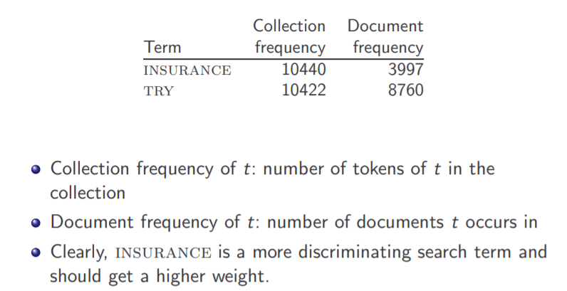
Collection frequency Vs Document frequency

Slide 14
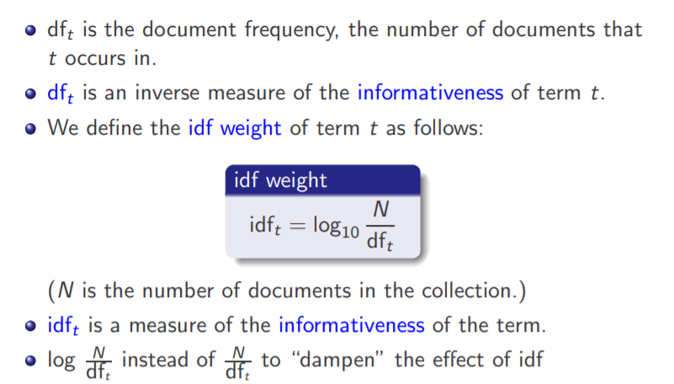
Inverse document frequency

Slide 15
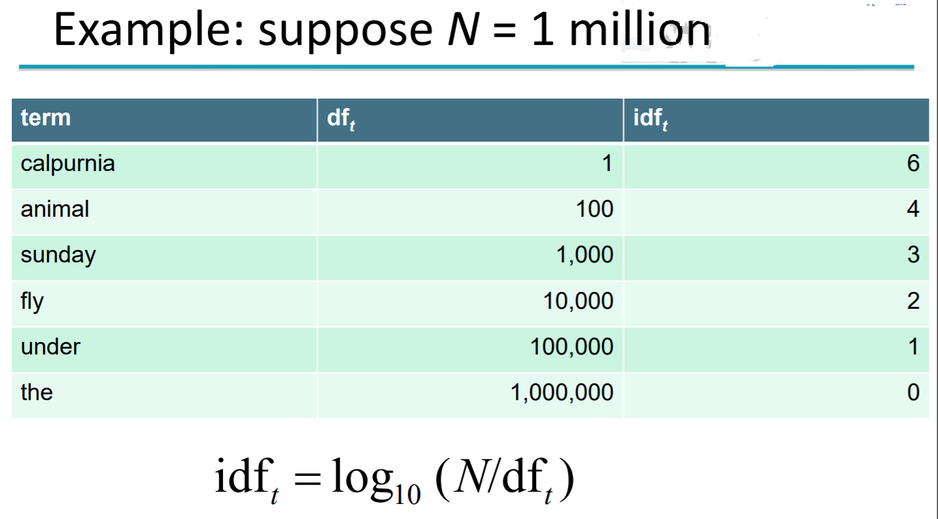
idf example

Slide 16
Effect of idf on ranking
Does idf have an effect on ranking for one-term queries, like
Robotics ---- idf has no effect
idf affects the ranking of documents for queries with at least two terms
For the query capricious person, idf weighting makes occurrences of capricious count for much more in the final document ranking than occurrences of person.

Slide 17
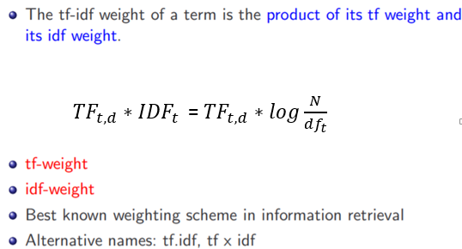
TF * IDF

Slide 18
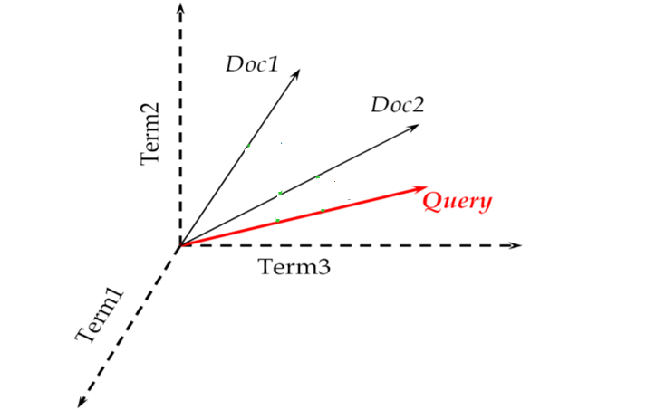
Document query representation

Slide 19
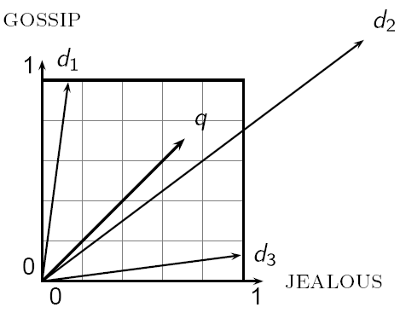


Euclidean distance
Sec. 6.3
The Euclidean distance between q
and d₂ is large even though the
distribution of terms in the query q and the distribution of
terms in the document d₂ are
very similar.
Query: ( t1, t2, t3)
Doc1: (4t1, 4t2, 4t3)
Doc2: (3t1,2t2)
ED(Query,Doc1) =
$$\sqrt{3^{2}+3^{2}+3^{2}}=\sqrt{27}$$
ED(Query,Doc2) =
$$\sqrt{2^{2}+1^{2}}=\sqrt{5}$$

Slide 20
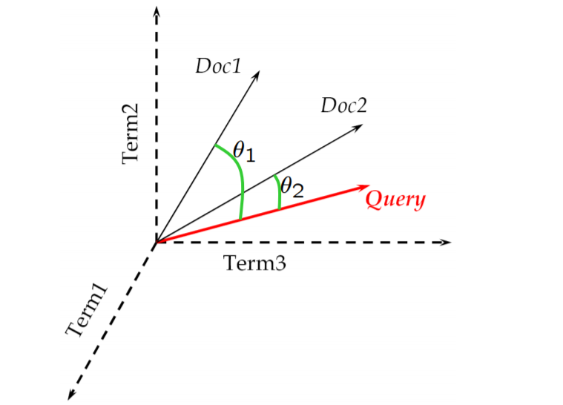
Cosine similarity between query and document

Slide 21
Cosine Similarity
Query Vector
Inner Product
Length
Normalization
Document Vector

Slide 22
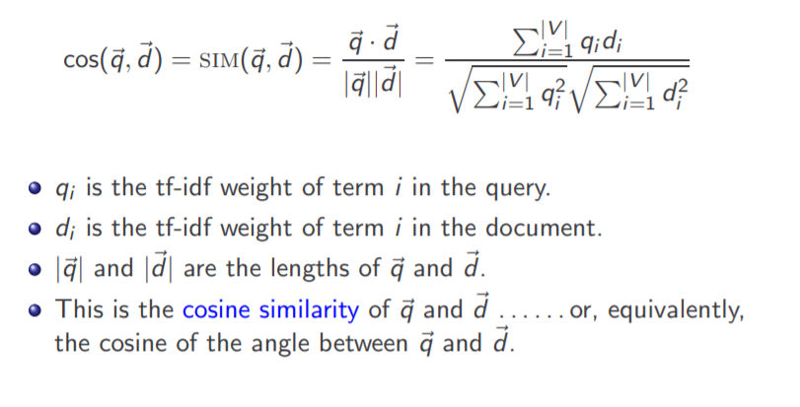
Cosine similarity between query and document

Slide 23
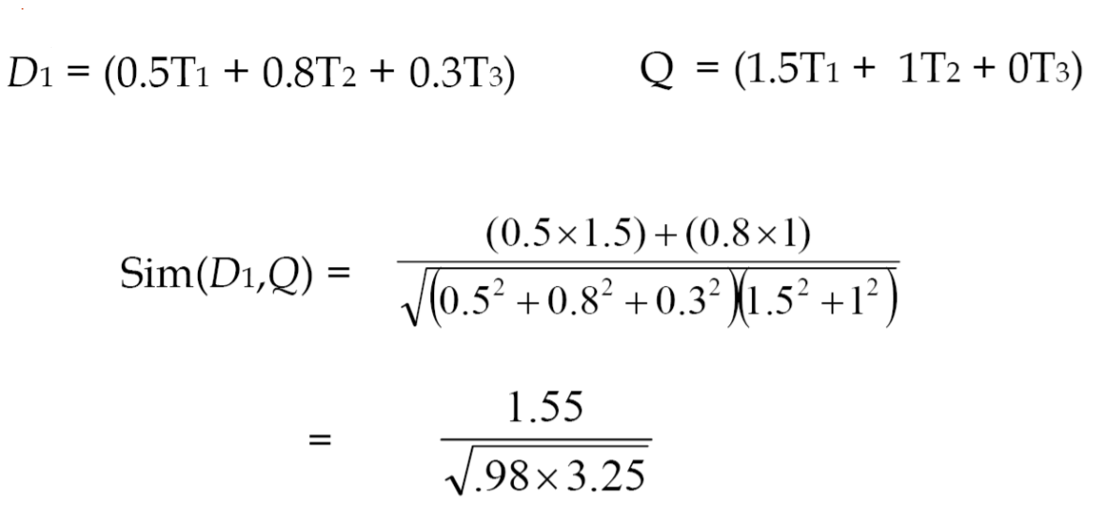
Cosine similarity : example

Slide 25
Computing Similarity Scores
1.0
0.8
0.6
0.4
0.2
0.2
0.4
0.6
0.8
1.0

Slide 26
Other Vector Space Similarity Measures
Simple Matching:
Cosine Coefficient:
Dice’s Coefficient:
Jaccard’s Coefficient:

Slide 27
Vector Space Similarity Measures
Again consider the following two document and the query vectors:
D₁ = (0.8, 0.3)
D₂ = (0.2, 0.7)
Q = (0.4, 0.8)
Computing similarity using Jaccard’s Coefficient:
Computing similarity using Dice’s Coefficient:
sim(Q, D₁) = 0.73
sim(Q, D₂) = 0.96

Slide 28
Length normalization
Sec. 6.3
A vector can be (length-) normalized by dividing each of its components by its length – for this we use the L₂ norm:
Dividing a vector by its L₂ norm makes it a unit (length) vector (on surface of unit hypersphere)
Effect on the two documents d1 and d2 (d1 appended to itself), they have identical vectors after length-normalization.
Long and short documents now have comparable weights
Doc1: (2t1,2t2,2t3,2t4)→(1/4)( 2t1, 2t2, 2t3, 2t4) = (0.5t1, 0.5t2, 0.5t3, 0.5t4)
Doc2:( 4t1,4t2, 4t3, 4t4) → (1/8) (4t1, 4t2,4t3,4t4) = (0.5t1, 0.5t2, 0.5t3, 0.5t4)

Slide 29
IR: Problem
Document collection:
Documents | D₁ | D₂ | D₃ | D₄ | D₅
Terms | t₁ | t₂ | t₂ t₃ t₂ t₃ t₃ | t₃ t₂ t₁ t₂ | t₁ t₁
D₁ |  |  | D₂ |  |  | D₃ |  |  | D₄ |  |  | D₅
Term | Freq |  | Term | Freq |  | Term | Freq |  | Term | Freq |  | Term | Freq
t₁ | 1 |  | t₂ | 1 |  | t₂ t₃ | 2 3 |  | t₁ t₂ t₃ | 1 2 1 |  | t₁ | 2
Sequential Index:
Inverted Index/TD matrix
 | D₁ | D₂ | D₃ | D₄ | D₅
t₁ | 1 | 0 | 0 | 1 | 2
t₂ | 0 | 1 | 2 | 2 | 0
t₃ | 0 | 0 | 3 | 1 | 0
Boolean Retrieval:
Q₁ = t₁ OR t₂
Q₂ = t₁ AND t₂
Q₃ = t₁ OR (t₂ AND t₃)
Q₄ = t₂ NOT (t₁ OR t³)
Weighted Boolean Retrieval:
Q₁ = t₂ OR t₃ weighted query terms: wt(t₁) = 2, wt(t₂) = 3, wt(t₃) = 4
D₁, D₂, D₃, D₄, D₅
D₄
D₁, D₃, D₄, D₅
D₂
 | D₂ | D₃ | D₄
Score | 1*3=3 | 2*3+3*4=18 | 2*3+1*4=10
Rank | 3 | 1 | 2

Slide 30
 | D₁ | D₂ | D₃ | D₄ | D₅
t₁ | 1 | 0 | 0 | 1 | 2
t₂ | 0 | 1 | 2 | 2 | 0
t₃ | 0 | 0 | 3 | 1 | 0
Vector-based Retrieval: Q₁ = (0, 0.3, 0.4)
Inverted Index:
Compute tf*idf term weights: w_{ki} = weight of term k in document i f_{ki} = frequency of term k in document i N_{d} = number of documents in collection d_{k} = number of documents in which term k appears (postings)
N_{d} = 5, d₁ = 3, d₂ = 3, d₃ = 2
 | D₁ | D₂ | D₃ | D₄ | D₅
t₁ | 1*log(5/3) =.222 | 0 | 0 | 1*log(5/3) =.222 | 2*log(5/3) =.444
t₂ | 0 | 1*log(5/3) = .222 | 2*log(5/3) = .444 | 2*log(5/3) = .444 | 0
t₃ | 0 | 0 | 3*log(5/2) = 1.194 | 1*log(5/2) = .398 | 0
Rank the documents using cosine similarity
SIM(Q₁, D₁) = SIM(Q₁, D₅) = 0
SIM(Q₁, D₂) =
SIM(Q₁, D₃) =
SIM(Q₁, D₄) =
 | D₁ | D₂ | D₃ | D₄ | D₅
Score | 0 | 0.6 | 0.959 | 0.918 | 0
Rank | 4 | 3 | 1 | 2 | 4

Slide 31
